Slide 1
Does race signify ancestry?
Module 2: Science and Identities

Slide 2
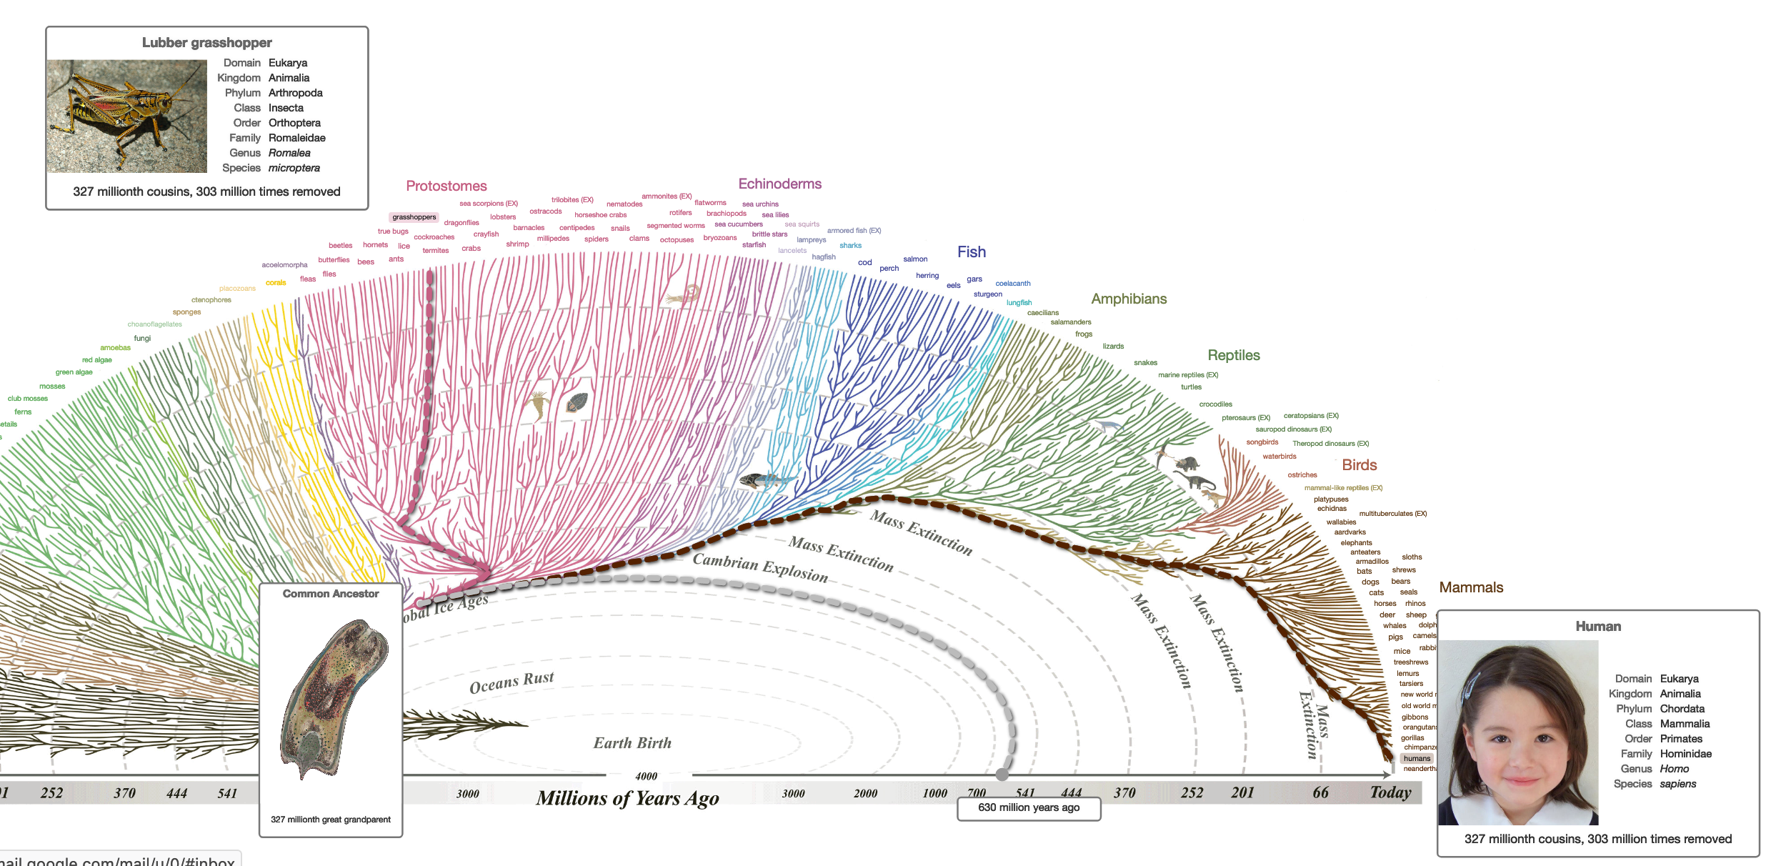
All organisms descended from a common ancestor

Slide 3
We use phylogenies to show descent from a common ancestor
Phylogeny: a visual hypothesis of the evolutionary history of a group of species, populations, or genes
A branch point ( ) represents the common ancestor between two groups

Slide 4
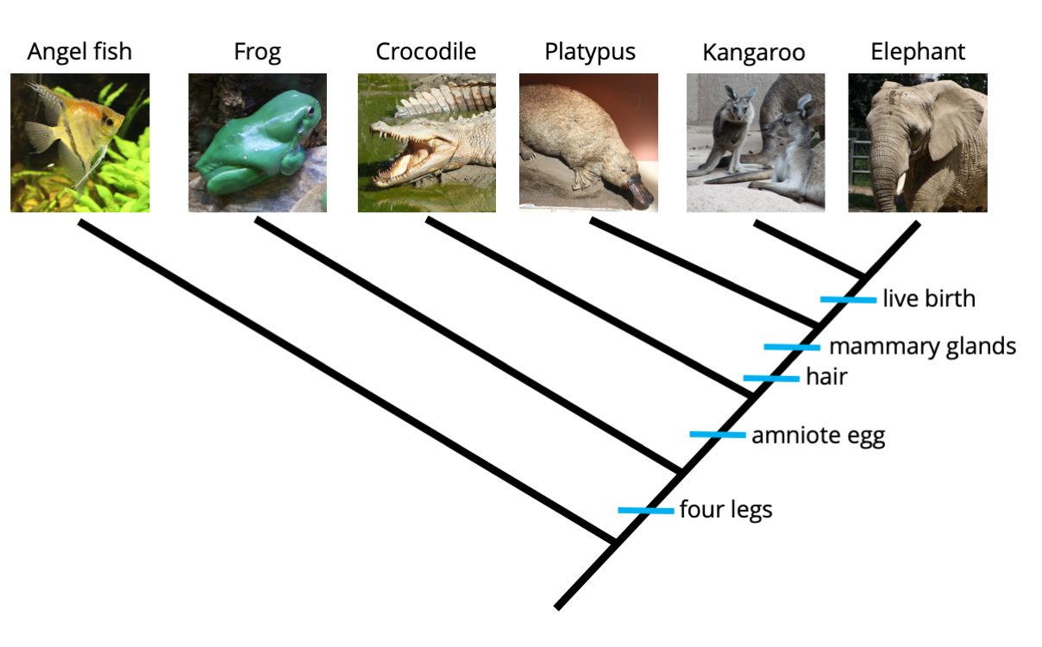
Phylogenies are built on shared traits
Synapomorphy: trait shared by all groups with a shared ancestor
Homologous traits: traits similar due to common ancestry
Morphological
Molecular

Slide 5

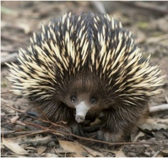
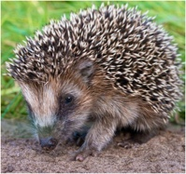
Phylogenies try to avoid being built on analogous traits
Analogous traits: traits similar due to adaptation to similar environments but in different evolutionary lineages
Notes:
Echidnas and hedgehogs share many traits, spines, long noses, soft bellies. These traits evolved separately in different evolutionary lineages. They did not evolve due to shared ancestry.
Note that echidnas and hedgehogs are not closely related to porcupines.
How do we avoid building phylogenies based on analogies? Use genetic data to build phylogenetic trees.

Slide 6
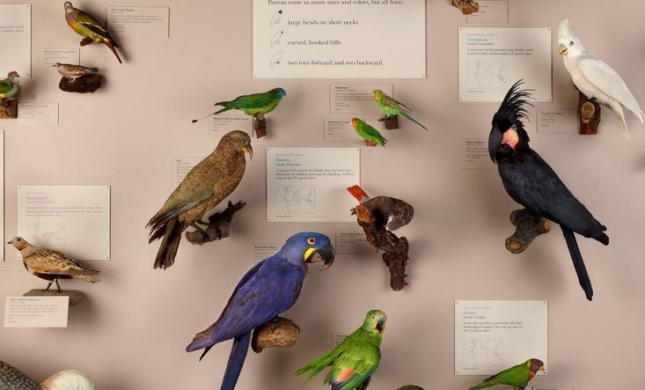
Let’s build a tree!
1) Choose shared traits
2) Create a trait matrix
1
4
2
Traits | 1 | 2 | 3 | 4
Beak shape
Feather color
Feather crest
Body size
3
Parrots and doves at the Field Museum

Slide 7
Let’s build a tree!
1) Choose shared traits
2) Create a trait matrix
1
4
2
Traits | 1 | 2 | 3 | 4
Beak shape | Curved | Curved | Curved | Curved
Feather color
Feather crest
Body size
3
Parrots and doves at the Field Museum

Slide 8
Let’s build a tree!
1) Choose shared traits
2) Create a trait matrix
1
4
2
Traits | 1 | 2 | 3 | 4
Beak shape | Curved | Curved | Curved | Curved
Feather color | Contrast | Contrast | Contrast | Blend
Feather crest
Body size
3
Parrots and doves at the Field Museum

Slide 9
Let’s build a tree!
1) Choose shared traits
2) Create a trait matrix
1
4
2
Traits | 1 | 2 | 3 | 4
Beak shape | Curved | Curved | Curved | Curved
Feather color | Contrast | Contrast | Contrast | Blend
Feather crest | Yes | Yes | No | No
Body size
3
Parrots and doves at the Field Museum

Slide 10
Let’s build a tree!
1) Choose shared traits
2) Create a trait matrix
1
4
2
Traits | 1 | 2 | 3 | 4
Beak shape | Curved | Curved | Curved | Curved
Feather color | Contrast | Contrast | Contrast | Blend
Feather crest | Yes | Yes | No | No
Body size | Small | Large | Large | Large
3
Parrots and doves at the Field Museum

Slide 11
Let’s build a tree!
1) Choose shared traits
2) Create a trait matrix
1
4
2
Traits | 1 | 2 | 3 | 4
Beak shape | Curved (1) | Curved (1) | Curved (1) | Curved (1)
Feather color | Contrast (1) | Contrast (1) | Contrast (1) | Blend (0)
Feather crest | Yes (1) | Yes (1) | No (0) | No (0)
Body size | Small (1) | Large (0) | Large (0) | Large (0)
3
Parrots and doves at the Field Museum
Notes:
Stress that when creating a trait matrix, it is important to choose traits that are yes/no, either/or, 0/1. This greatly simplifies using the trait matrix to build the phylogenetic tree.

Slide 12
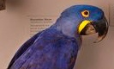
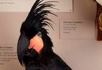
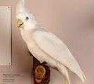
Let’s build a tree!
Traits | 1 | 2 | 3 | 4
Beak shape | Curved (1) | Curved (1) | Curved (1) | Curved (1)
Feather color | Contrast (1) | Contrast (1) | Contrast (1) | Blend (0)
Feather crest | Yes (1) | Yes (1) | No (0) | No (0)
Body size | Small (1) | Large (0) | Large (0) | Large (0)
1) Choose shared traits
2) Create a trait matrix
3) Draw the tree
Is there a trait shared by all organisms? If so, put it at the root of the tree.
Then…what trait is shared by the most organisms? Put the organism without that trait on one branch, and the addition of the trait on the other branch.
…
What trait is unique to only one organism?
4
beak shape
3
color
feather crest
2
size
1
Notes:
Stress that phylogenies are hypotheses, we would build a different tree if we used different traits, can even build a different tree using the same traits

Slide 13





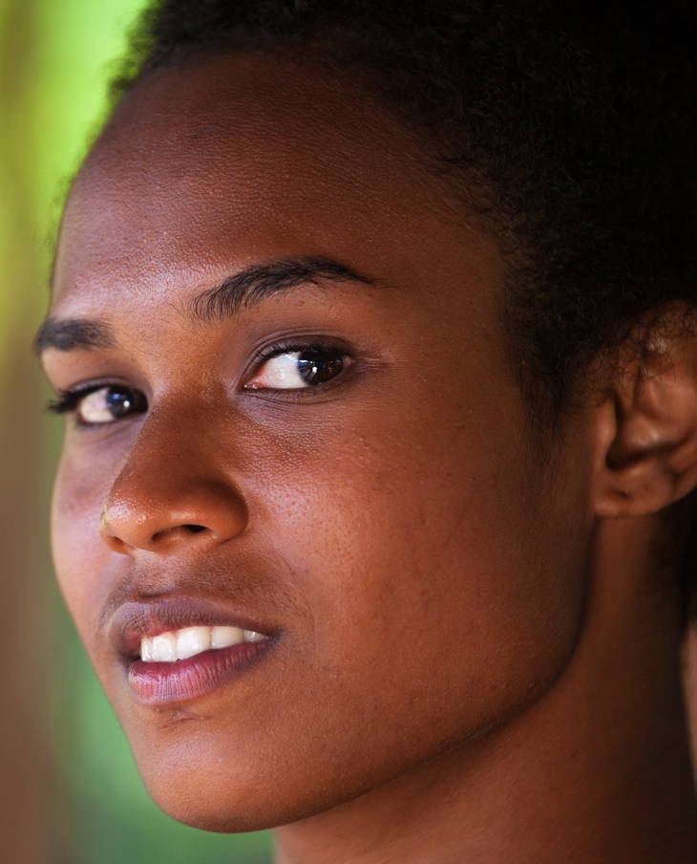
Now try it with human populations!
1
2
3
4
5
6
Notes:
We can also use phylogenetic trees to show the evolutionary history of different populations, including human populations.
Use these pictures to create a trait matrix and build a phylogenetic tree.
----
1: German
2: Iranian
3: Mayan
4: Han Chinese
5: West African
6: Papua New Guinean
----
Photo credits
1: Marco Alhelm, Shutterstock
2: Slava SelfStudio, Shutterstock
3: Katiekk, Shutterstock
4: Creative Family, Shutterstock
5: Daniel M Ernst, Shutterstock
6: Hagen Production, Shutterstock

Slide 14





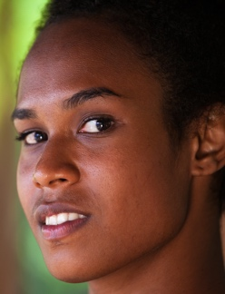
Now try it with human populations!
Traits | 1 | 2 | 3 | 4 | 5 | 6
1) Choose shared traits
2) Create a trait matrix
3) Fill in the tree
Notes:
First choose traits that are shared among these human populations, then fill in this trait matrix. Once finished with the trait matrix, place the human populations at the end of the branches on this tree. Make sure to indicate where variation in each trait evolved on the tree.
What characteristics did you use to build your phylogenetic tree?
Why did you choose those characteristics to build your phylogenetic tree?
What populations on your tree are most closely related to each other? Most distantly related?
Do you think your tree accurately represents the evolutionary relationships among these populations? Why or why not?

Slide 15




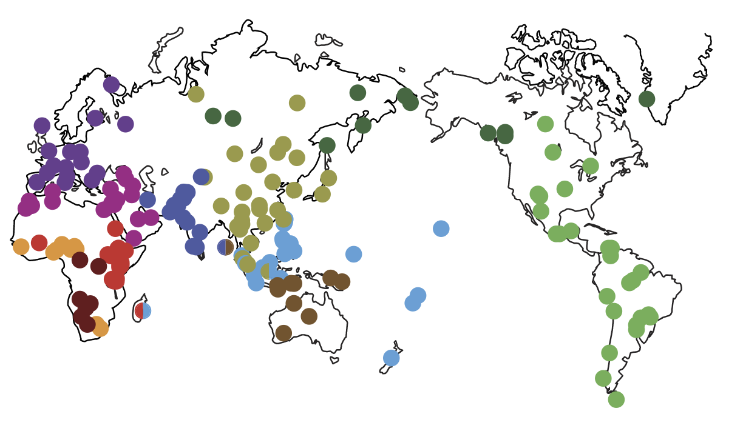


Compare the tree you built to the tree built from genetic sequences
5
1
2
6
4
3
Notes:
Here is a tree that was built on genetic sequences.
In what ways does your tree differ from the tree built on genetic sequences?
What does this say about relying on morphological traits to build phylogenetic trees?
Conclusions:
Morphological traits do not build accurate phylogenetic trees.
----
Duda, P., Jan Zrzavý Human population history revealed by a supertree approach. Sci Rep 6, 29890 (2016). https://doi.org/10.1038/srep29890

Slide 16




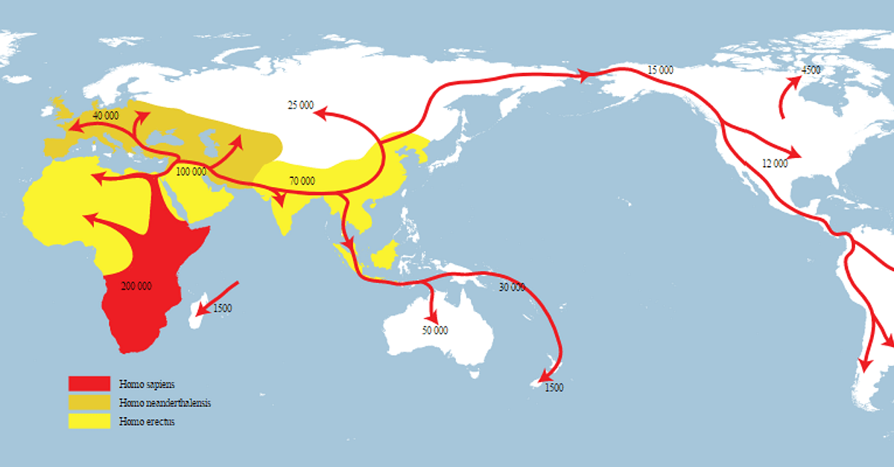


The genetic tree reflects the migration of ancient human populations
5
1
2
6
4
3
Many current human populations are admixed, formed from the exchange of genes between previously geographically separated populations
Notes:
The genetic tree reflects geography and how humans populated the world. Humans (indicated in red on this map) originated in Africa about 200,000 years ago. A subset of humans migrated out of Africa. Some of those humans migrated to Europe, the rest to Asia. From central Asia, humans colonized SE Asia and Oceania and other humans colonized east Asia. From east Asia, a subset of humans migrated across the Bering Strait and into the Americas.
In the last 500 years, human populations have more easily and rapidly moved across the world. Now, most human populations are admixed – they have been formed from the exchange of genes between previously geographically separated populations. For examples, the Americas are populated by people with genes descending from people who migrated across the Bering Strait about 15,000 years ago, Europeans who moved to the New World 500 years ago, African slaves those Europeans brought with them to the Americas, and people from across the world who have immigrated to the Americas. Note that this current admixed population in the Americas reflects a history of violence.
The human pictures used in this activity represent non-admixed human populations. Adding admixed human populations would greatly complicate this tree. Think about it. Where would you put an African American on this tree? Admixture makes it even harder to accurately build a phylogenetic tree from morphological traits.
Main conclusion: Human characteristics cannot be used to accurately understand human ancestry.

Slide 17

What are the main take aways?
5-minute Discussion

